Slide 1
Tools and Agents

Slide 2


Slide 3
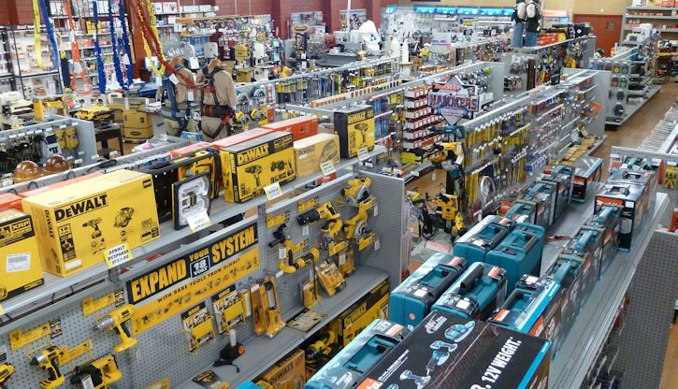

Slide 4
Models themselves are just (unplugged) neural networks

Slide 5

How to open it to the world?

Slide 6

Teach it to call functions!
function(a, b, …)

Slide 7
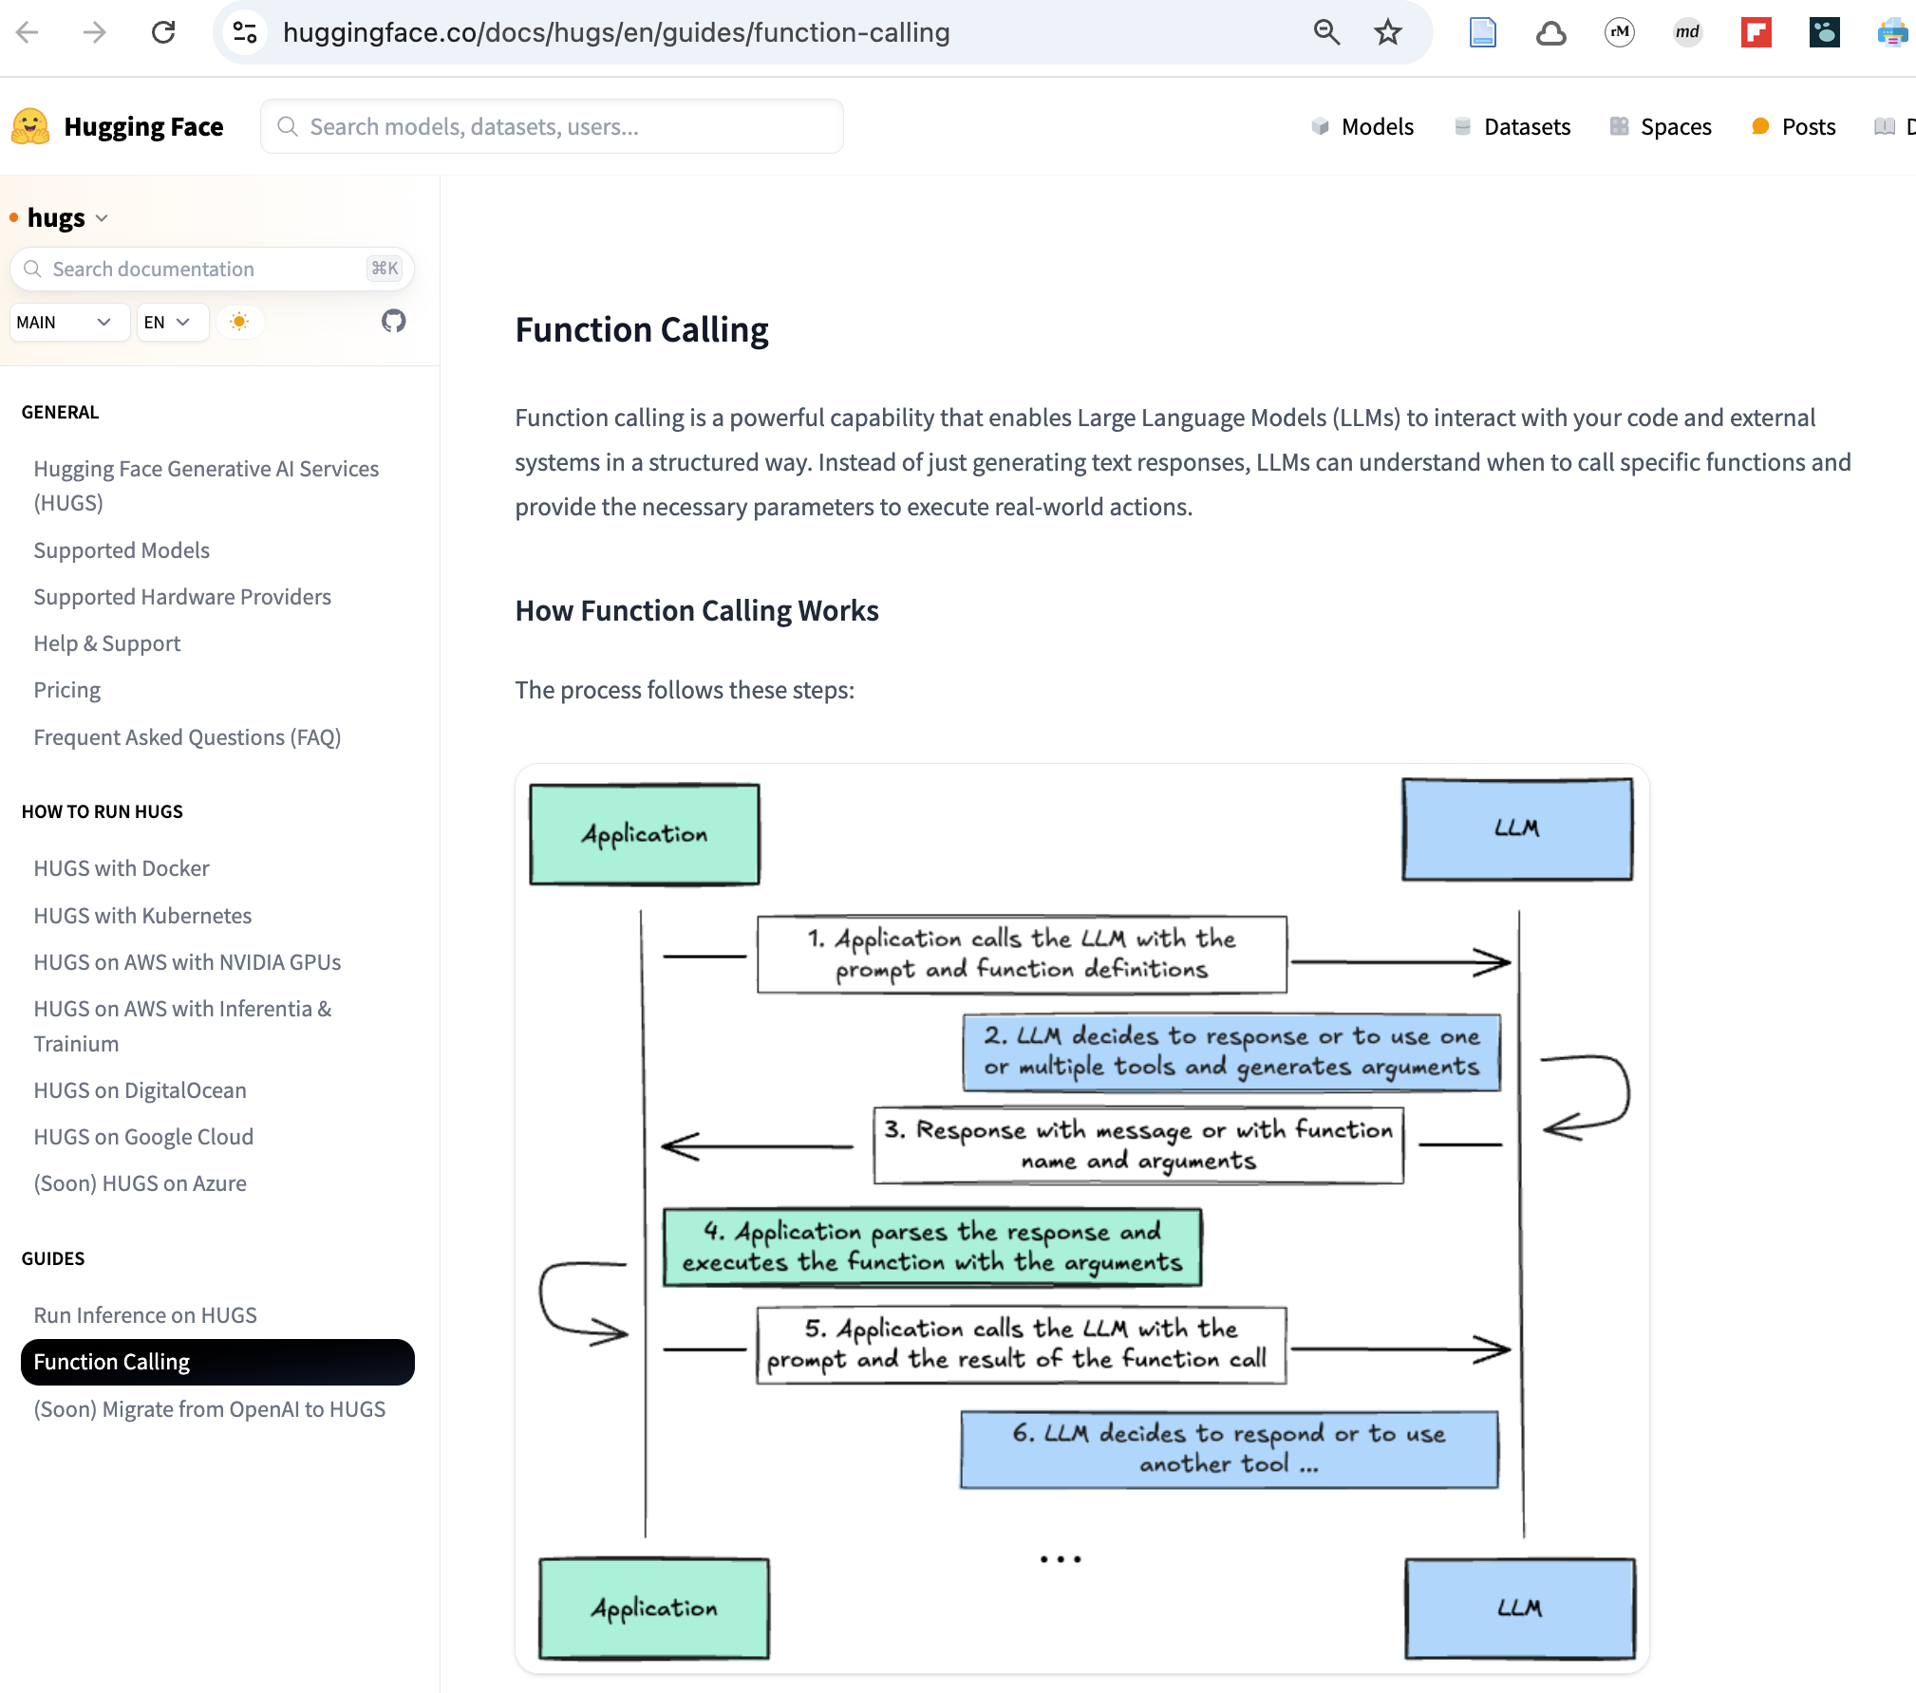
S/LLM needs to be trained for that…

Slide 8
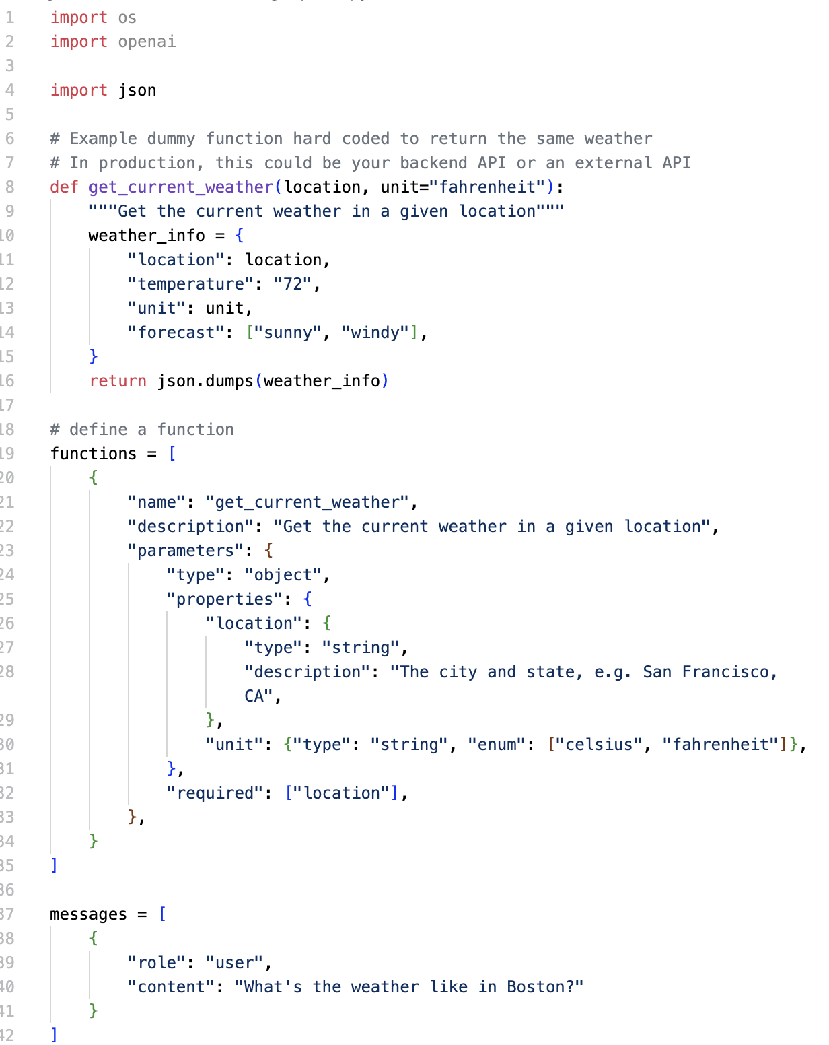
„Raw” function calling is tedious

Slide 9
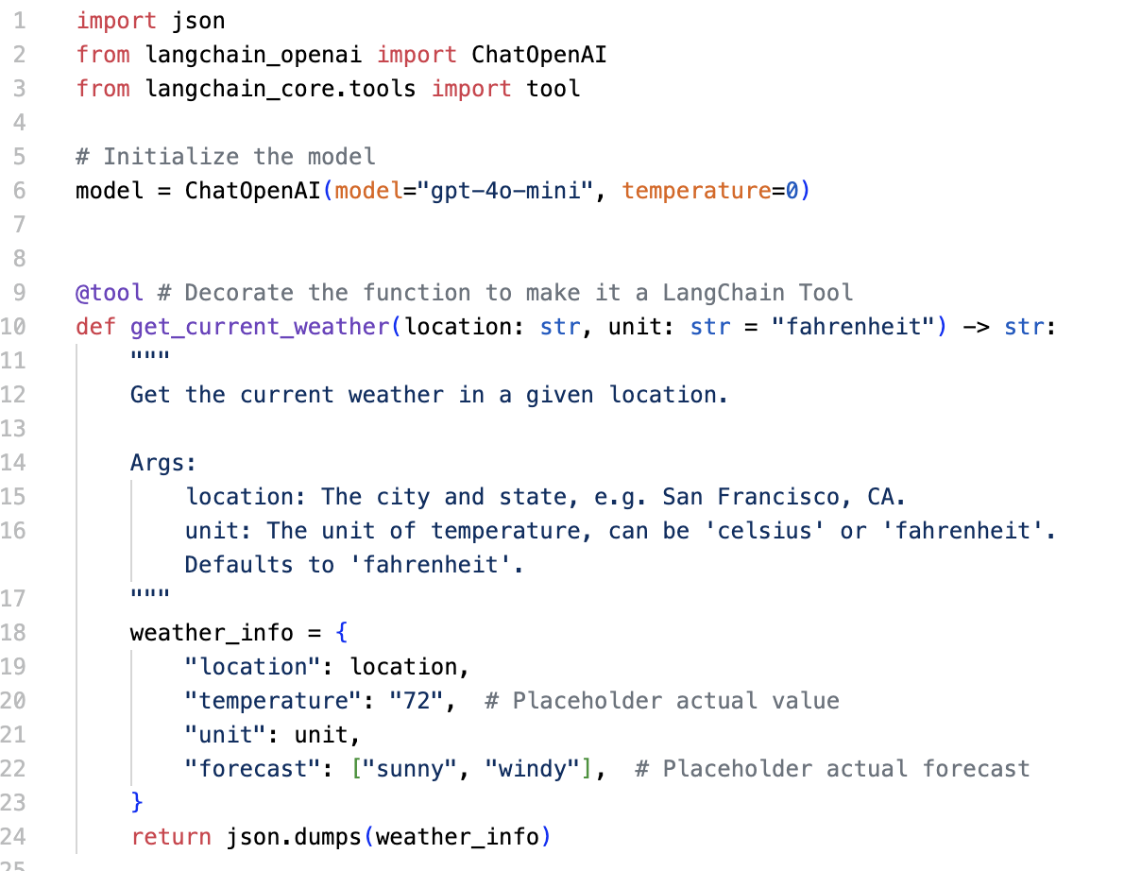
Fortunately, „there is an app for that” ☺

Slide 10
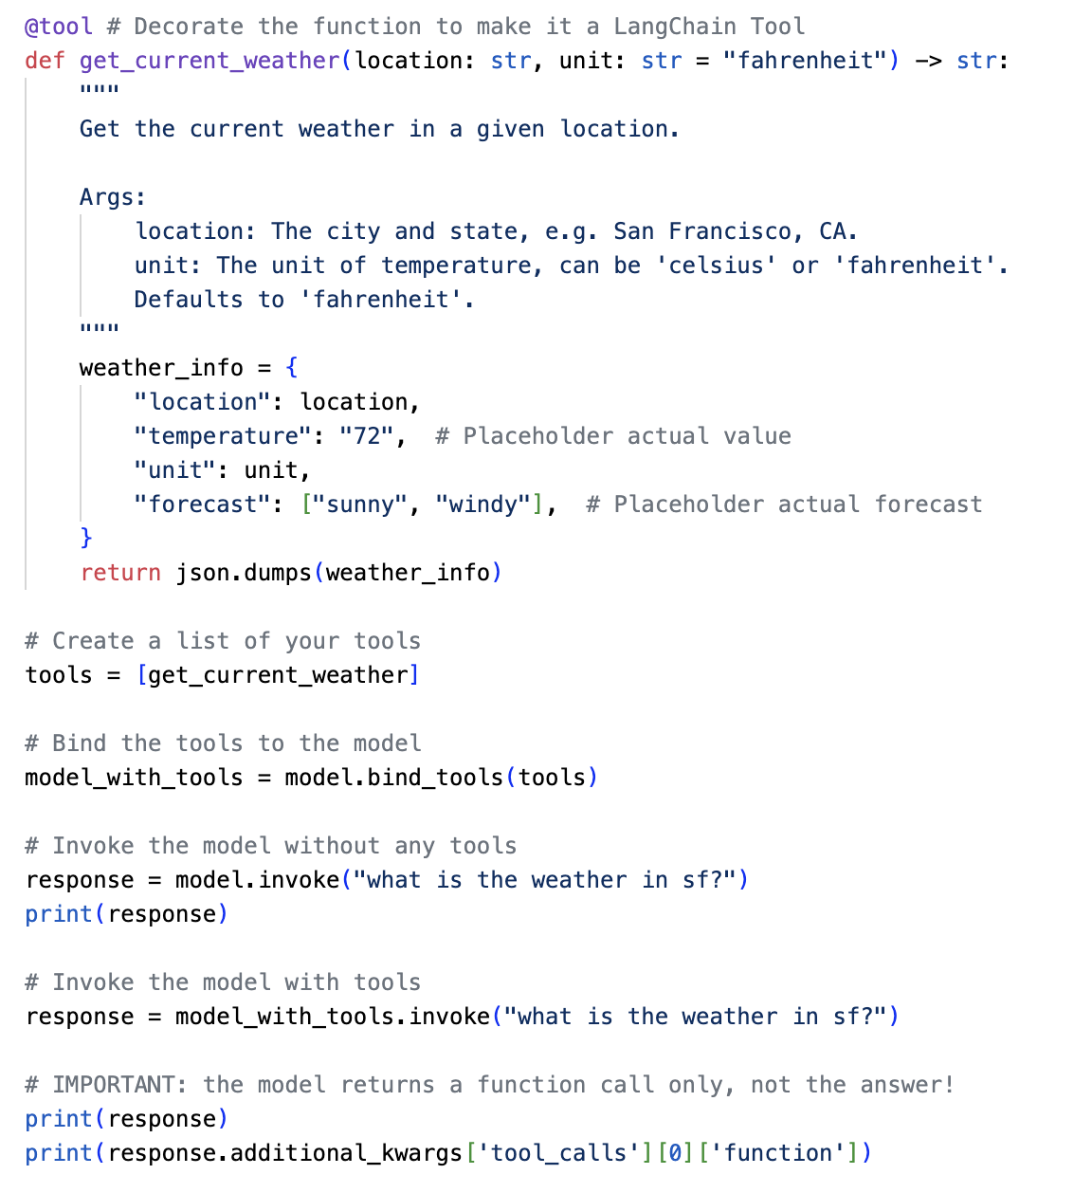
LLM picks-up the apppropriate tool
But do not invoke the LLM!

Slide 11
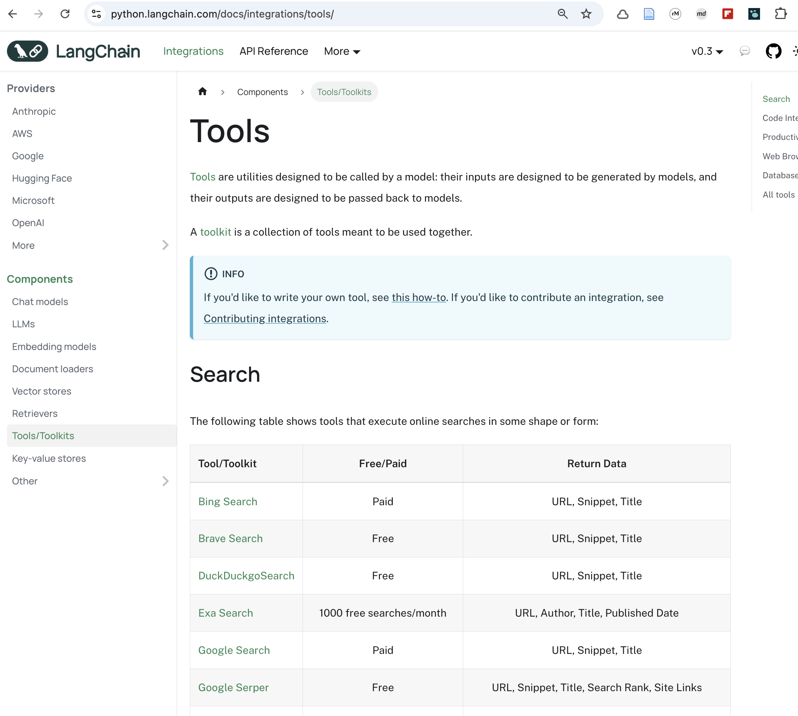
There are plenty of tools out there…

Slide 12
But you can create Your own!

Slide 13
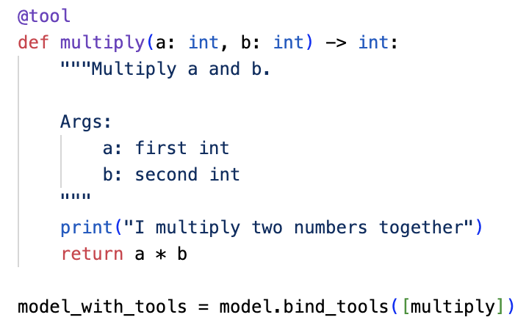
Simple math

Slide 14
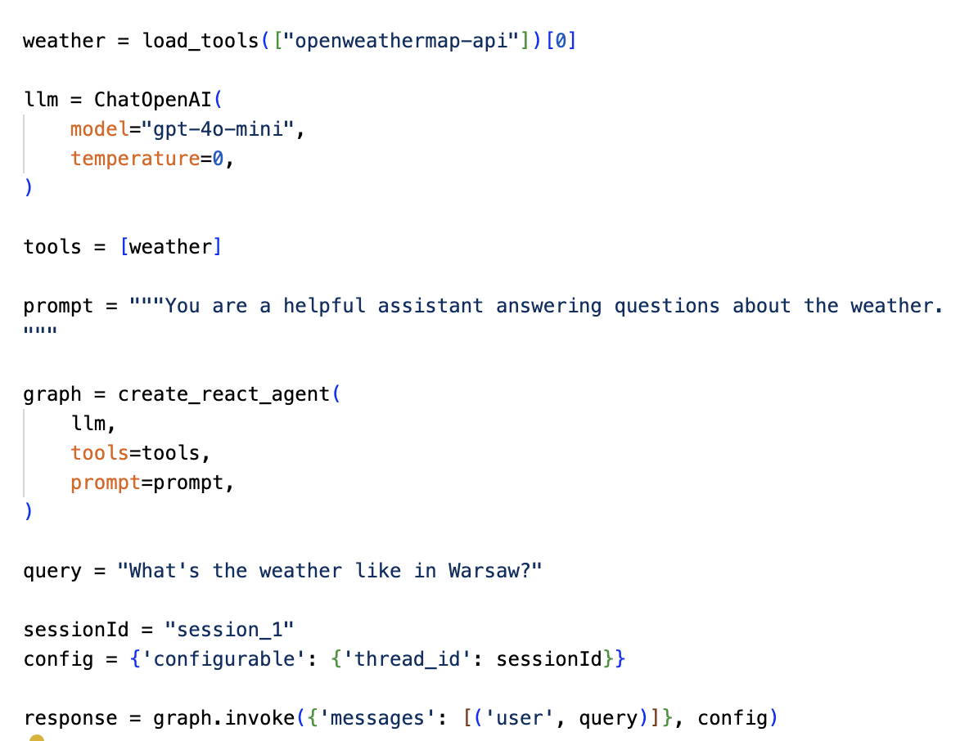
Get weather

Slide 15
The smartest are ReAct Agents

Slide 16
